Slide 1
Optimization Quiz
12/3/19

Slide 2
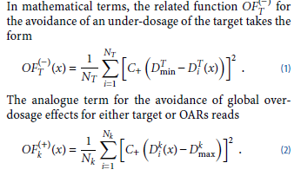

Q1
Write the equation for the cost function.

Slide 3
Q2
What are the two main types of optimization algorithms?
Give an example of each.
deterministic algorithms like the gradient approach
These techniques are applied to optimization problems where the objective functions are convex and therefore only a global minimum and no local minima exist
Fast
stochastic methods, like simulated annealing

